Slide 1
Creational Design Patterns - Part II
Object Oriented Software Design
CS2062

Slide 2
Factory
Use when objects have to be created for the client without exposing the logic to a client
Object is referred through a common interface
Very commonly used pattern

Slide 3
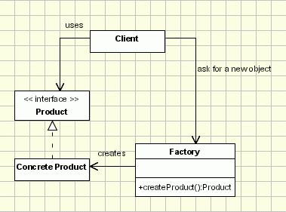
Factory

Slide 4
Factory
public interface Shape {
void draw();
}
public class Rectangle implements Shape {
public void draw() {
System.out.println("Inside Rectangle::draw() method.");
}
}
public class Square implements Shape {
public void draw() {
System.out.println("Inside Square::draw() method.");
}
}
public class ShapeFactory {
public Shape getShape(String shapeType){
if(shapeType == null){ return null; }
if(shapeType.equalsIgnoreCase(“SQR")){ return new Square(); } else
}
}

Slide 5
Factory Method
AKA virtual constructor
Somewhat similar to Factory
Defines an interface for creating an object
Lets subclasses decide which class to instantiate

Slide 6
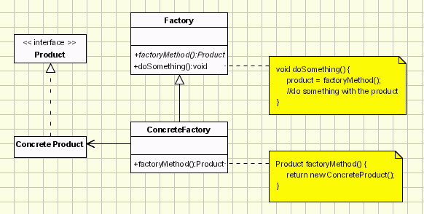
Factory Method

Slide 7
Factory Method
public interface Product { }
public class ConcreteProduct1 implements Product { }
public class ConcreteProduct2 implements Product { }
public abstract class Factory{
public Product anOperation(int type) {
Product product = factoryMethod(type);
return product;
}
protected abstract Product factoryMethod(int type);
}
public class ConcreteFactory extends Factory{
protected Product factoryMethod(int type) {
return new ConcreteProduct1();
}
}

Slide 8
Factory Method
public class Client {
public static void main( String arg[] ) {
Factory fac= new ConcreteFactory(); fac.anOperation(1);
}
}

Slide 9
Abstract Factory
AKA Kit
Offers the interface for creating a family of related objects, without explicitly specifying their classes
Looks similar to Factory method at a glance

Slide 10
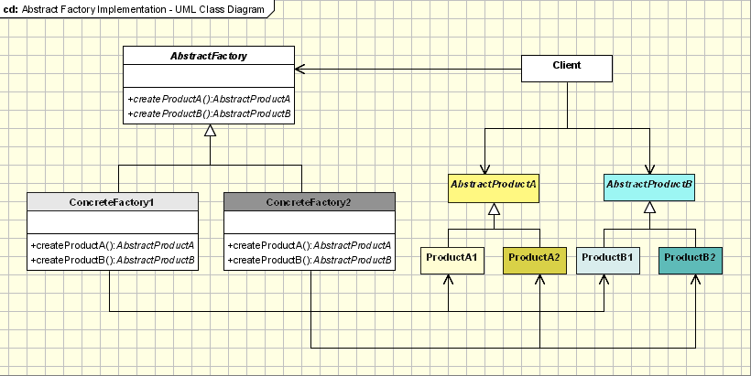
Abstract Factory

Slide 11
Abstract Factory
abstract class AbstractProductA{
public abstract void operationA1();
public abstract void operationA2();
}
class ProductA1 extends AbstractProductA{
ProductA1(String arg){ }
public void operationA1() { };
public void operationA2() { };
}
class ProductA2 extends AbstractProductA{
ProductA2(String arg){ }
public void operationA1() { };
public void operationA2() { };
}

Slide 12
Abstract Factory
abstract class AbstractProductB{
public abstract void operationB1();
public abstract void operationB2(); }
class ProductB1 extends AbstractProductB{
ProductB1(String arg){}
public void operationB1();
public void operationB2();
}
class ProductB2 extends AbstractProductB{
ProductB2(String arg){}
public void operationB1();
public void operationB2();
}

Slide 13
Abstract Factory
abstract class AbstractFactory{
abstract AbstractProductA createProductA();
abstract AbstractProductB createProductB();
}
class ConcreteFactory1 extends AbstractFactory{
AbstractProductA createProductA(){
return new ProductA1("ProductA1");
}
AbstractProductB createProductB(){
return new ProductB1("ProductB1");
}
}
class ConcreteFactory2 extends AbstractFactory{
AbstractProductA createProductA(){
return new ProductA2("ProductA2");
}
AbstractProductB createProductB(){
return new ProductB2("ProductB2");
}
}

Slide 14
References
http://www.oodesign.com/
http://sourcemaking.com/design_patterns
http://www.tutorialspoint.com/design_pattern/index.htm

